Slide 1
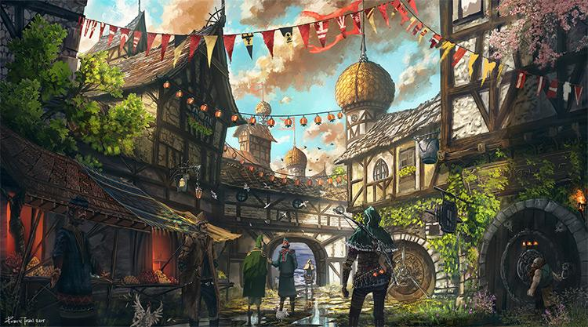

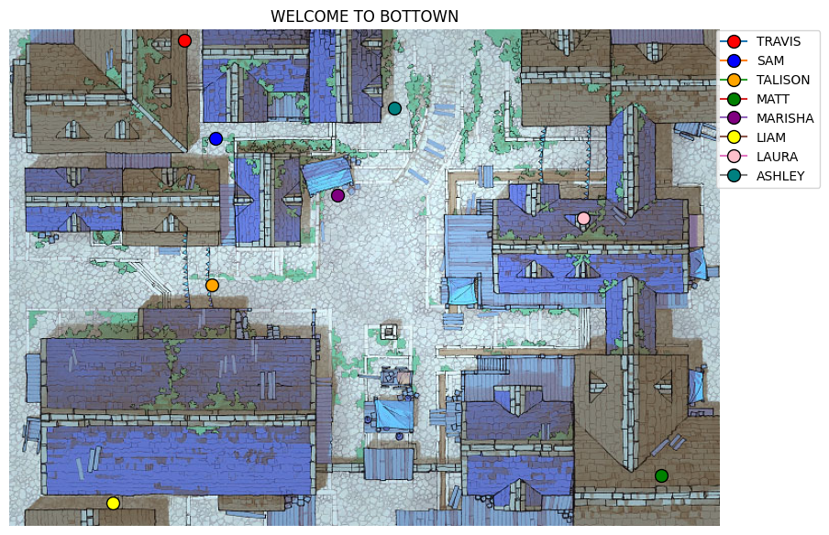
Chatbot Town
Christopher Pang
Jeffery Ott

Slide 2
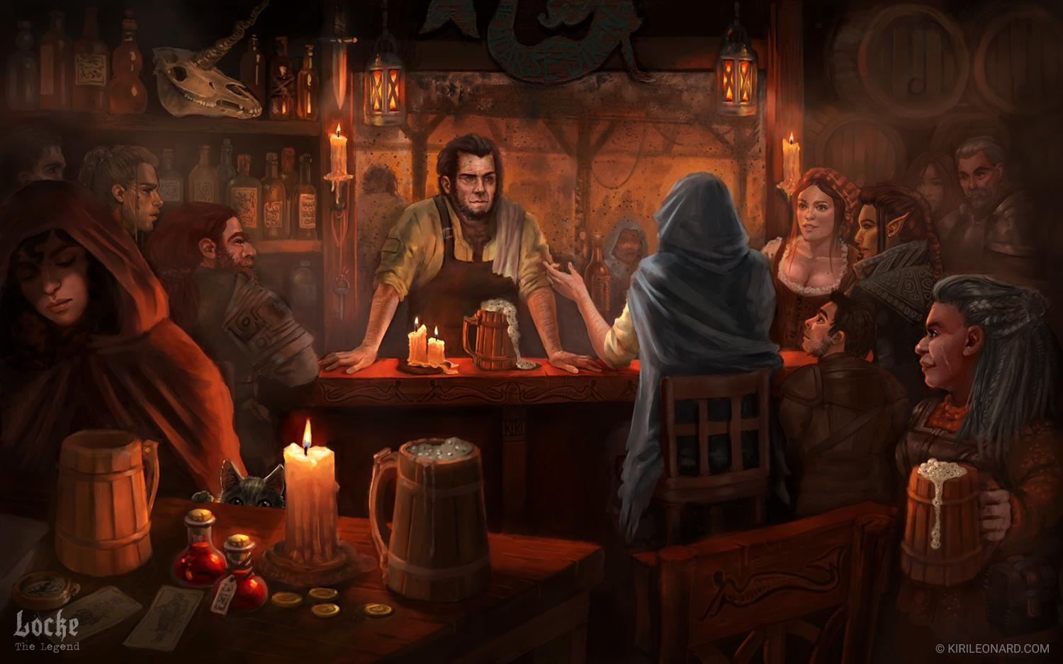
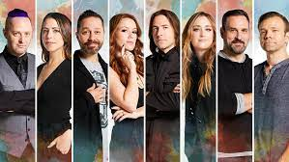
What was the project goal?
Our goal: Create a town of generative chatbots that have fantasy conversation with each other about dungeons and dragons gameplay.
Each bot is trained on a different players responses there are 7 players and 1 DM (Pictured Below)
During the “day” the bots move randomly around the “town” and have conversations whenever they interact, these conversations are stored
Notes:
Talisin, laura, sam, marisha, matt, ashley, travis, liam
multi person podcasts based around DND Thousand of hours of fantasy conversation in reply-response format
Generative vs retrieval based

Slide 3

Project workflow
Find and Prepare data
Creating a program to parse those podcast transcript
Deploy in ‘town’
Pre Process data
Random walk bots around town and have convos with each other
Tokenize
Stemming
Lemmatizing
Parse trees
Word Vectors and model
Chatbot Type
Build a seq2seq model
Generative bot
Notes:
Retrieval is canned responses from database
Generative is bot stitches words together

Slide 4
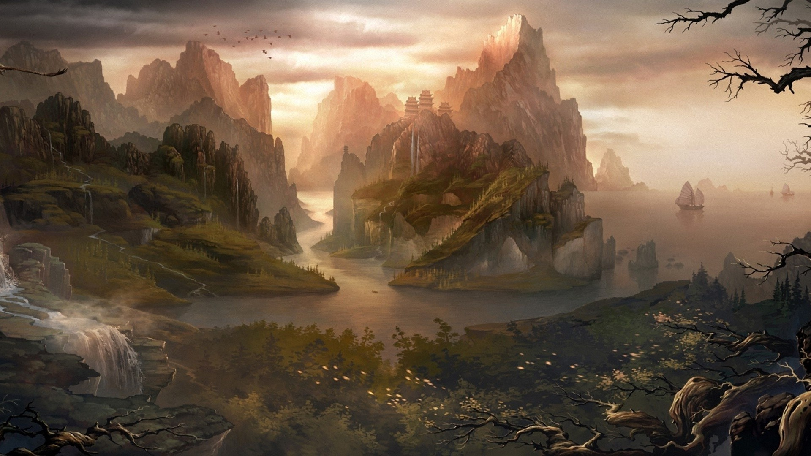
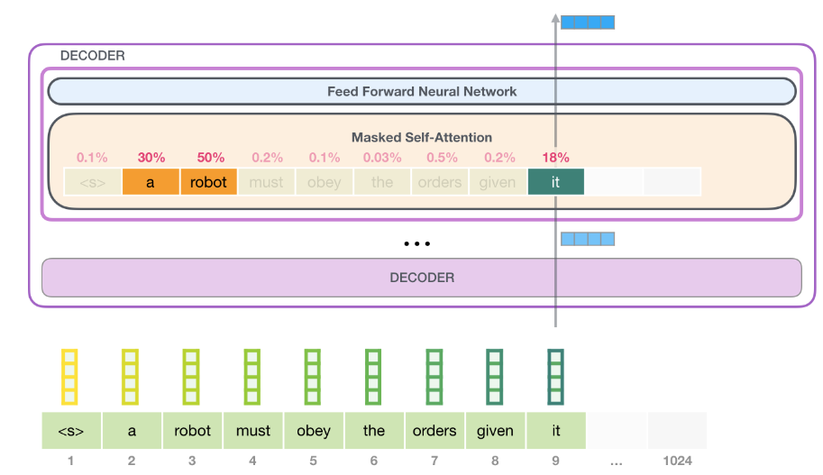
What did we try?
We used the transformers library and used transfer learning from Microsoft’s Large-scale Pretrained Response Generation Model (DialoGPT) that has been pretrained on 147M dialogue from Reddit. The model is based on the GPT-2 model.
Notes:
https://towardsdatascience.com/make-your-own-rick-sanchez-bot-with-transformers-and-dialogpt-fine-tuning-f85e6d1f4e30
https://jalammar.github.io/illustrated-gpt2/
Transformers library and Microsoft’s Large-scale Pretrained Response Generation Model (DialoGPT)
Not so long ago, Microsoft’s DialoGPT was added to the Transformers model collection. DialoGPT is a GPT-2 model, trained on 147M multi-turn dialogue from Reddit discussion thread (you can learn more about GPT-2 here). This model is ideally suited for creating a virtual character for a fascinating conversation and even in the small implementation option, it can maintain a coherent dialogue, which we will see now.

Slide 5
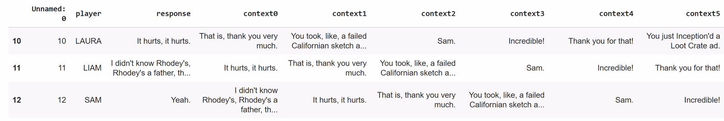
What did we try?
We then fine tuned each player model on 5 historical context and 1 response, which was from 900K lines of Critical Role podcast.
Notes:
https://towardsdatascience.com/make-your-own-rick-sanchez-bot-with-transformers-and-dialogpt-fine-tuning-f85e6d1f4e30
https://criticalrole.fandom.com/wiki/Transcripts
Critical Role is an American web series in which a group of professional voice actors play Dungeons & Dragons

Slide 6
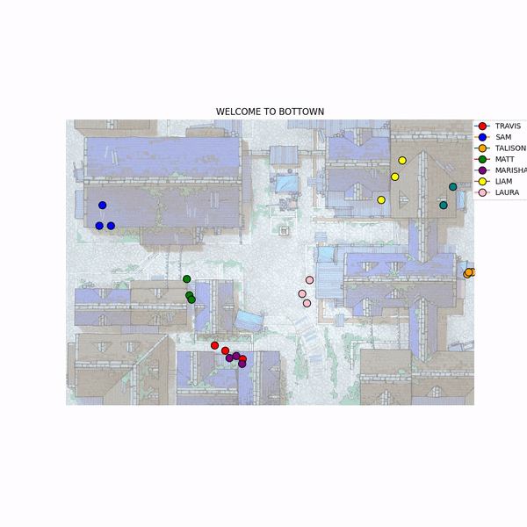
What went well?
Notes:
Training loss 1.9-2
Valdiaiton low perplexity is good. Perxplicty was 5.5-7
Diffusion of knowledge , ;from purple to red to green. Knowledge transfer
Touch upon the transfer of knowledge between bots

Slide 7
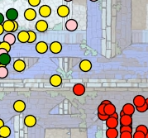
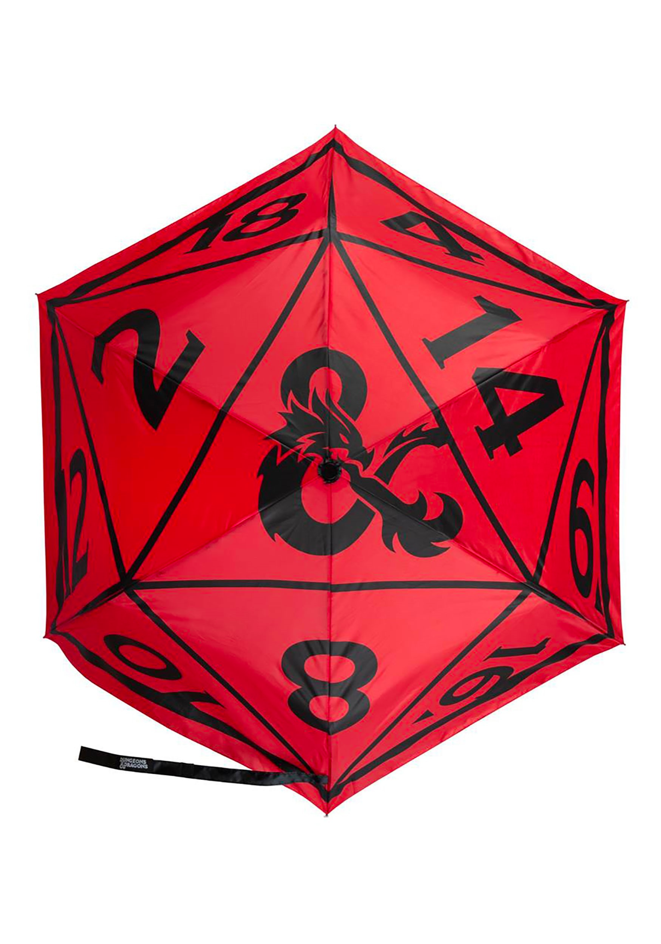
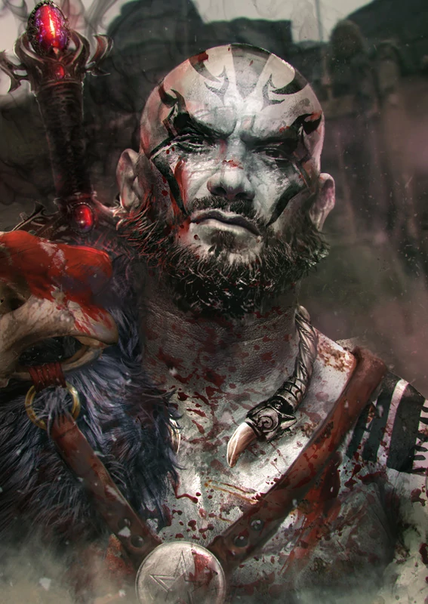
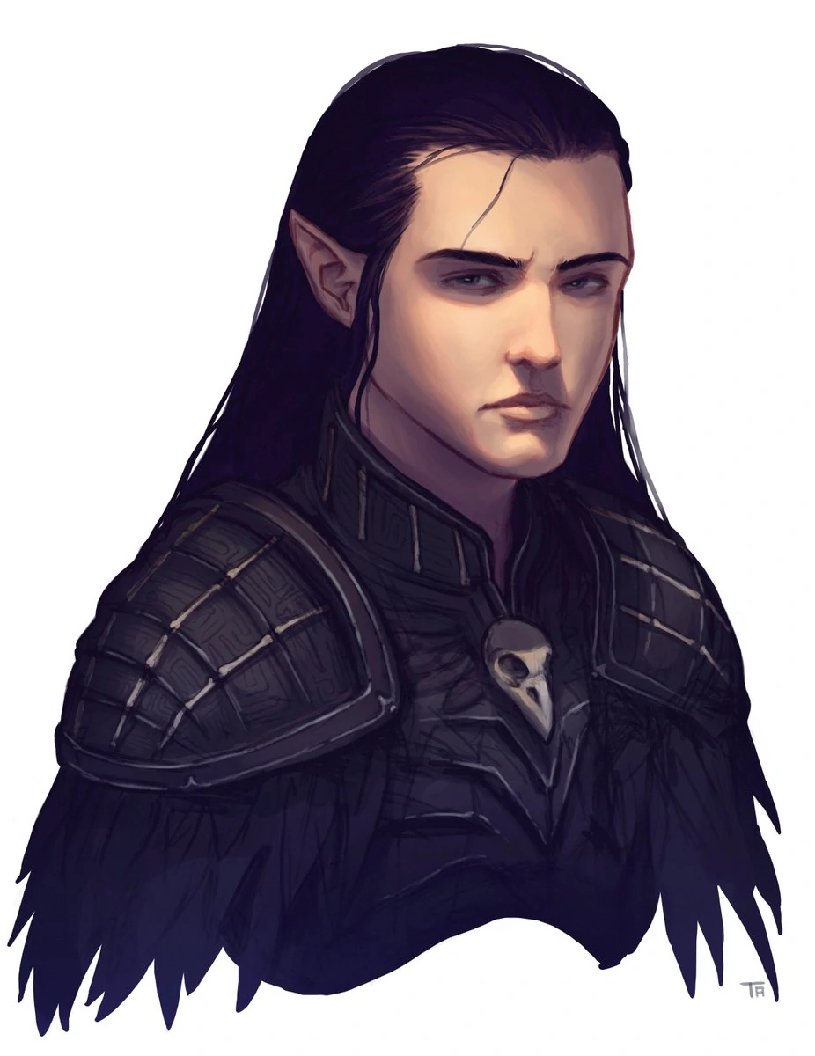
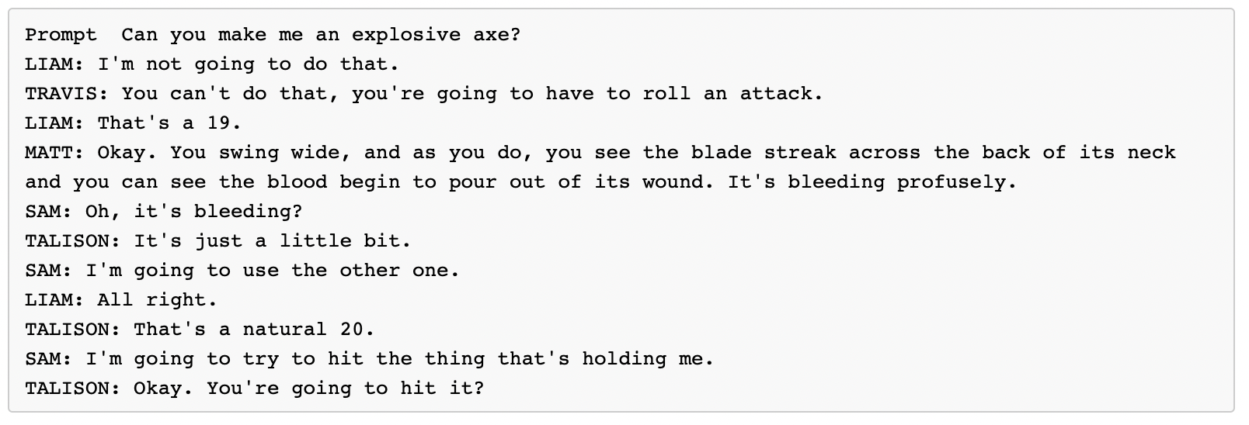
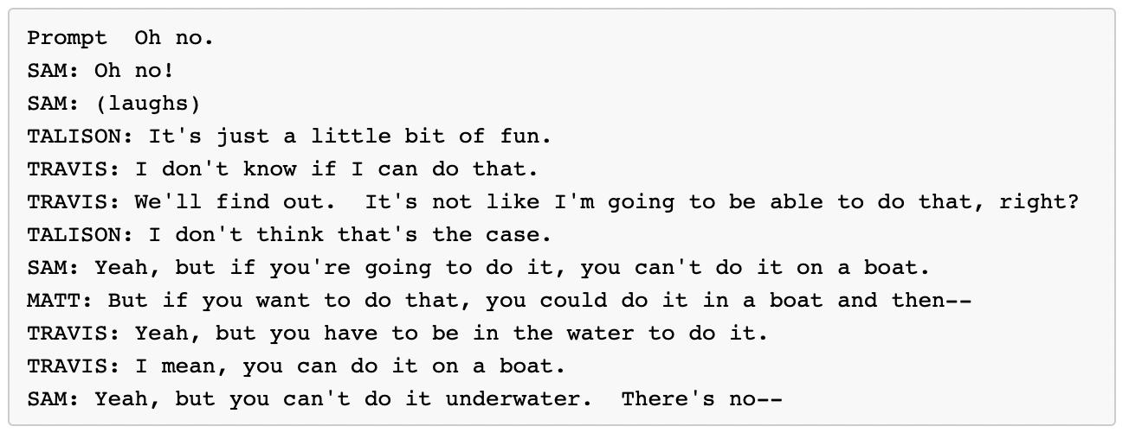
What went well?

Slide 8
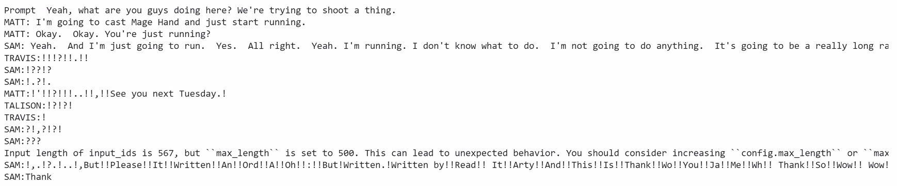
What didn’t go well?
The conversation degenerated when the chat history length got greater than ~100 length. But we “fixed” it by truncating earlier chat history.
Notes:
Hope its not some sentient being capable of machine language.
More seriously possible explanation: !? happens at end of statements. So for long chat history, the model outputs !?

Slide 9

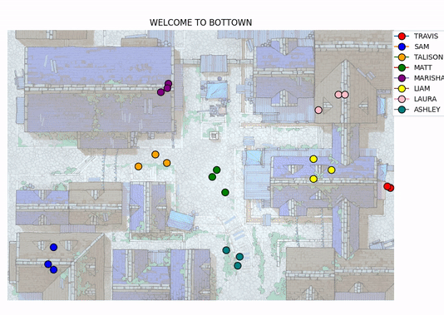
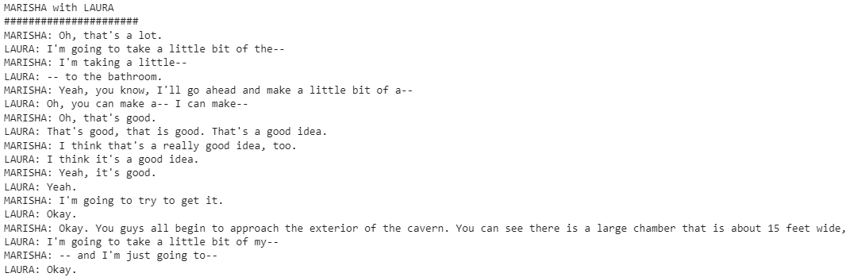
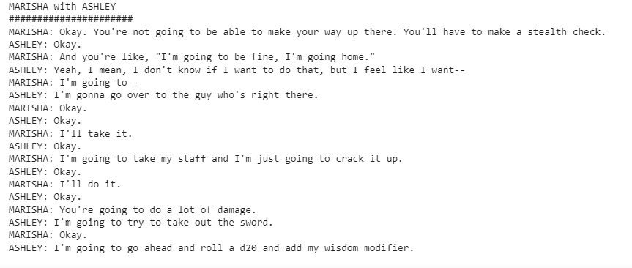
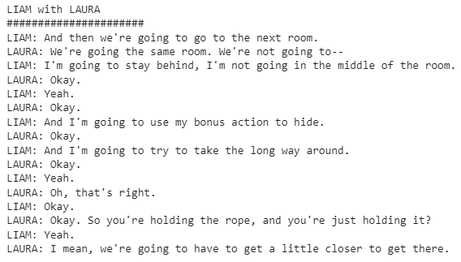
The town in action

Slide 10
Chatbot Town
Christopher Pang
Jeffery Ott

